Slide 1

Bandwidth efficient object recognition for drone swarms
School of Computer Science and Communication Systems
Master in Computer Science
Supervised by
Prof. Dario Floreano
Dr. Giuseppe Cocco
Fabian Schilling
Student
Marco Zoveralli
École polytechnique fédérale de Lausanne – A.Y. 2018/2019 – Marco Zoveralli – Sciper N. 267476

Slide 2
Project Overview
Motivation
Detection Accuracy: prediction by single drone may be unreliable
Consensus: autonomous swarms may need to agree on whether a given target is present
Bandwidth efficiency: especially relevant in urban environment
Goal
Determine the presence/absence of a target object with high accuracy
Proposed approach
Exploit multiple viewpoints
Estimations are done locally by each drone
Limited information exchange to save power, bandwidth and for scalability
What? – Related Work – How? – Progress
École polytechnique fédérale de Lausanne – A.Y. 2018/2019 – Marco Zoveralli – Sciper N. 267476
1/11
1/7
Notes:
When considering a set of devices performing object recognition, a swarm of drones in our case, what can happen is that some drone cannot predict the presence or absence of the object in a too reliable way. This is where a distributed solution comes into help: the devices that are part of the swarm put together the single predictions in order to get a more reliable one. One of the main requirements when considering such approaches, besides improving the accuracy of the predictions, is to save bandwidth.

Slide 3
Project Overview
Object detection for drone swarms
Single predictions may be unreliable
Distributed object detection algorithm
Trying to improve the accuracy of object recognition
Exploiting multiple viewpoints
Bandwidth consumption
Keeping bandwidth usage as low as possible
Autonomous swarm
Possibility of autonomously trigger more complex actions
Goal of the system: determining the presence/absence of a specified object
What? – Related Work – How? – Progress
École polytechnique fédérale de Lausanne – A.Y. 2018/2019 – Marco Zoveralli – Sciper N. 267476
1/11
1/7
Notes:
When considering a set of devices performing object recognition, a swarm of drones in our case, what can happen is that some drone cannot predict the presence or absence of the object in a too reliable way. This is where a distributed solution comes into help: the devices that are part of the swarm put together the single predictions in order to get a more reliable one. One of the main requirements when considering such approaches, besides improving the accuracy of the predictions, is to save bandwidth.

Slide 4
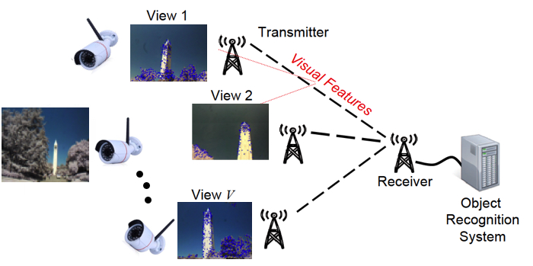
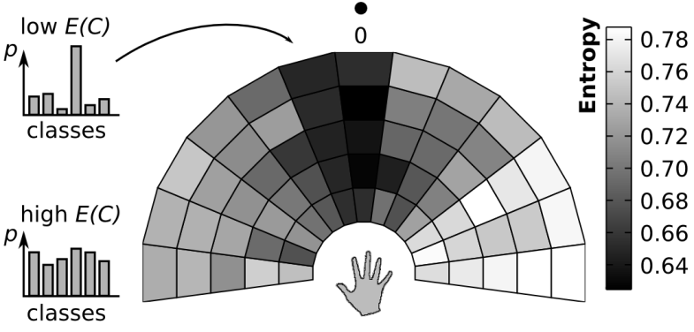
Related Work
A. Rahimpour et al., “Distributed Object Recognition in Smart Camera Networks,” 2016 IEEE Int. Conf. on Image Processing (ICIP), 2016.
Feature extraction performed by each camera
Feature sent to a base station, which performs
object detection
Lack of an autonomous set of devices that
triggers other events
H. Medeiros et al., "Distributed Object Tracking Using a Cluster-Based Kalman Filter in Wireless Camera Networks," IEEE Journal of Selected Topics in Signal Processing, 2008.
Distributed Kalman filter
Different goal
A. Giusti et al., "Cooperative sensing and recognition by a swarm of mobile robots," IEEE/RSJ International Conference on Intelligent Robots and Systems, 2012.
Interesting communication and consensus protocol
Human-computer interaction
Different setup, different goal
Classification task
What? – Related Work – How? – Progress
École polytechnique fédérale de Lausanne – A.Y. 2018/2019 – Marco Zoveralli – Sciper N. 267476
1/11
2/7
Notes:
Different assumption for giusti’s paper: they assume that while the protocol is running, the object is indeed there. Instead, we have to determine whether an object is there: there might be nothing as well.

Slide 5
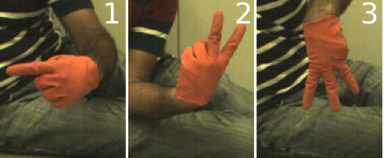
Related Work
Rahimpour et al. Distributed Object Recognition in Smart Camera Networks – 2016 IEEE
Feature extraction performed by each camera
Feature sent to a base station, which performs object detection
Lack of an autonomous set of devices
Rahimpour et al. Distributed Object Recognition in Smart Camera Networks – 2016 IEEE
Feature extraction performed by each camera
Feature sent to a base station, which performs object detection
Lack of an autonomous set of devices
Medeiros et al. Distributed Object Tracking Using a Cluster-based Kalman Filter in Wireless Camera Networks – 2008 IEEE
Networks
Distributed Kalman filter
Different goal
Giusti et al. Cooperative Sensing and Recognition by a Swarm of Mobile Robots – 2012 IEEE
Robots
Interesting communication and consensus protocol
Different assumptions, different goal
What? – Related Work – How? – Progress
École polytechnique fédérale de Lausanne – A.Y. 2018/2019 – Marco Zoveralli – Sciper N. 267476
1/11
2/4
Notes:
Different assumption for giusti’s paper: they assume that while the protocol is running, the object is indeed there. Instead, we have to determine whether an object is there: there might be nothing as well.

Slide 6
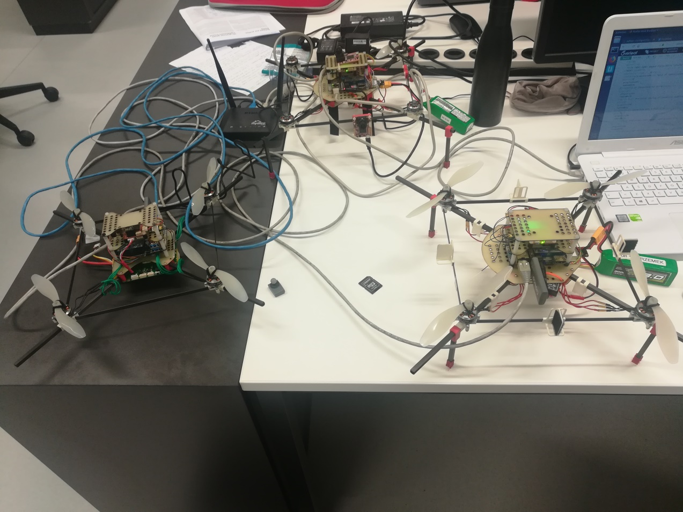
Simple Network Management Protocol
Setup
Embedded boards
Odroid XU4
Connectivity
WiFi Module 5
IEEE 802.11ac/a/b/g/n
Adhoc mode compatibility
Image Acquisition
OpenMV M7 camera
Various image sizes
Configurable frame rate
Connected via USB
What? – How? – Progress
École polytechnique fédérale de Lausanne – A.Y. 2018/2019 – Marco Zoveralli – Sciper N. 267476
3/4
Notes:
What does model checking do? A little background.

Slide 7
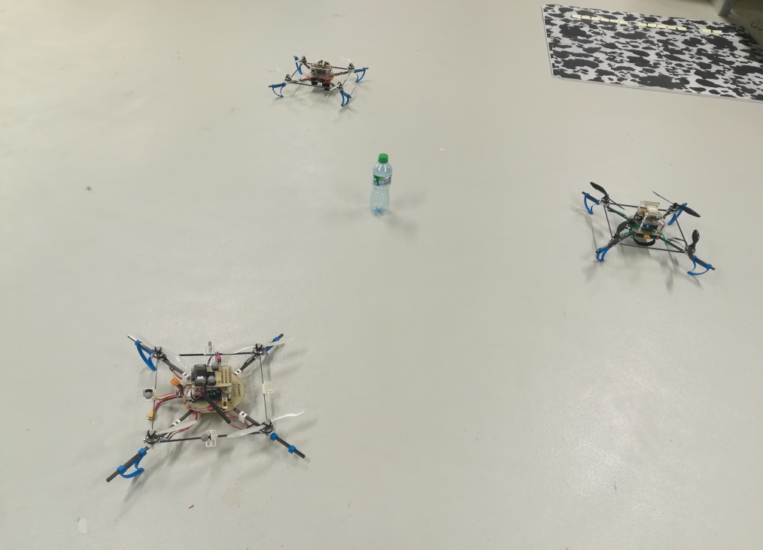
Simple Network Management Protocol
Hardware Selection and Validation
Hardware selection
Project inputs
Single-board computers: Odroid XU4
Image Acquisition: M7 camera
Our proposal
Connectivity: WiFi Module 5
Hardware validation
Connectivity tests
Adhoc mode compatibility
Network throughput
Network stability
Object detection tests
Setup of a machine learning framework on the ARMv7 architecture
MSCOCO pre-trained neural network
Average computational time: 200ms per prediction
Accurate predictions over a defined set of objects (e.g. bottle, keyboard)
What? – Related Work – How? – Progress
École polytechnique fédérale de Lausanne – A.Y. 2018/2019 – Marco Zoveralli – Sciper N. 267476
3/7
Notes:
What does model checking do? A little background.

Slide 8
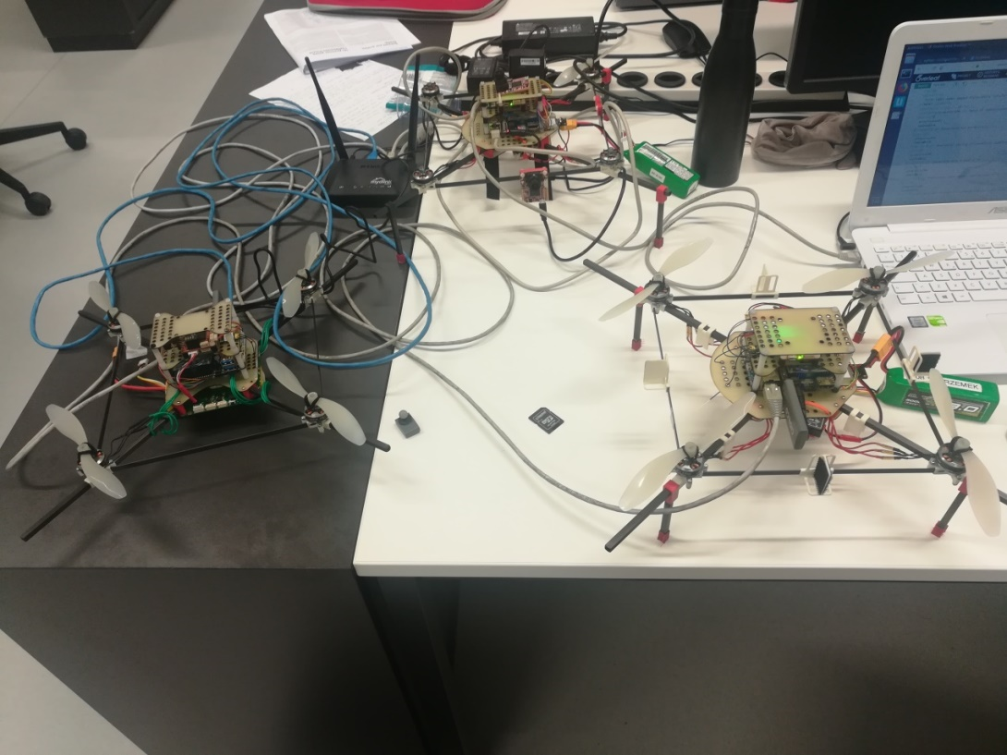
Simple Network Management Protocol
Hardware Selection and Functionality Tests
Single-board computers
Odroid XU4
Connectivity
WiFi Module 5
Adhoc mode compatibility
Object Detection
OpenMV M7 camera
Setup of a machine learning framework on ARMv7 architecture
MSCOCO pre-trained neural network
Connectivity tests: throughput and network stability
Object detection tests
Average computational time: 200ms per prediction
Accurate predictions over a defined set of objects (e.g. bottle, keyboard)
What? – Related Work – How? – Progress
École polytechnique fédérale de Lausanne – A.Y. 2018/2019 – Marco Zoveralli – Sciper N. 267476
3/4
Notes:
What does model checking do? A little background.

Slide 9
Simple Network Management Protocol
Preliminary Tests
Connectivity
Setup of an adhoc network with three devices
Throughput and connection persistence tests
On-drone object recognition
MSCOCO pre-trained neural network
200/300ms per prediction
Accurate predictions for a defined set of objects
E.g. bottle, person, keyboard, cellphone ..
What? – How? – Progress
École polytechnique fédérale de Lausanne – A.Y. 2018/2019 – Marco Zoveralli – Sciper N. 267476
4/5
Notes:
What does model checking do? A little background.

Slide 10
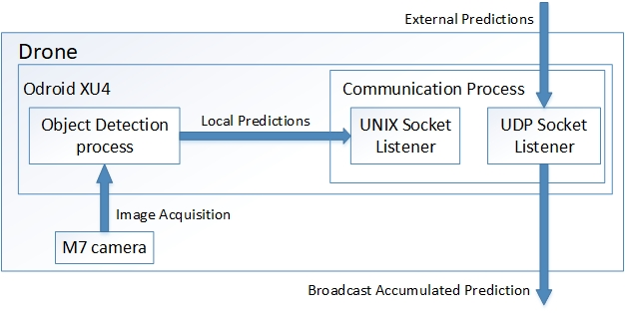
Protocol Design
Intra-host
Inter-host
Aggregate local predictions with received ones
Weighted average over the set of predictions
Emission of final result
Challenges
Give the proper weight to each device’s prediction
Reach a consensus
Handle packet losses
What? – Related Work – How? – Progress
École polytechnique fédérale de Lausanne – A.Y. 2018/2019 – Marco Zoveralli – Sciper N. 267476
1/11
4/7
Notes:
Infer about BIP, say that we discuss later about the tools

Slide 11
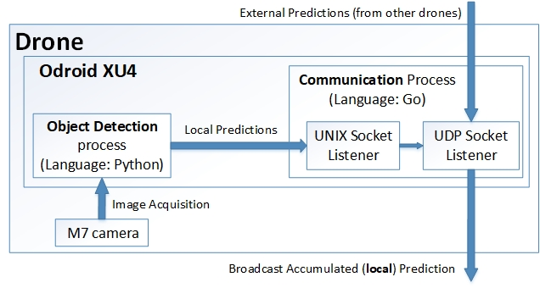
Protocol Design: Intra-host Computations
What? – Related Work – How? – Progress
École polytechnique fédérale de Lausanne – A.Y. 2018/2019 – Marco Zoveralli – Sciper N. 267476
1/11
4/7
Notes:
Infer about BIP, say that we discuss later about the tools

Slide 12
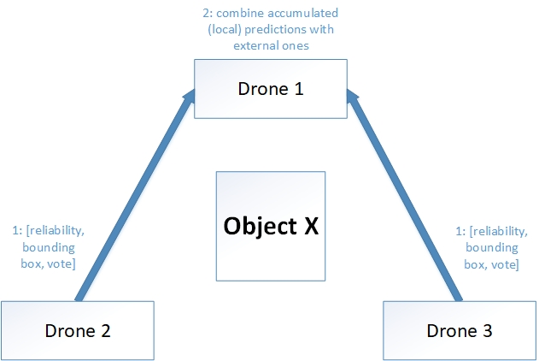
Protocol Design: Inter-host Communication
Intra-host
Inter-host
Aggregate local predictions with received ones
Weighted average over the set of predictions
Emission of final result
Challenges
Give the proper weight to each device’s prediction
Reach a consensus
Handle packet losses
What? – Related Work – How? – Progress
École polytechnique fédérale de Lausanne – A.Y. 2018/2019 – Marco Zoveralli – Sciper N. 267476
1/11
5/7
Notes:
Infer about BIP, say that we discuss later about the tools

Slide 13
Protocol Design: Main Challenges
Give the proper weight to each device’s prediction
Reach a consensus
Handle packet losses
What? – Related Work – How? – Progress
École polytechnique fédérale de Lausanne – A.Y. 2018/2019 – Marco Zoveralli – Sciper N. 267476
1/11
6/7
Notes:
Infer about BIP, say that we discuss later about the tools

Slide 14
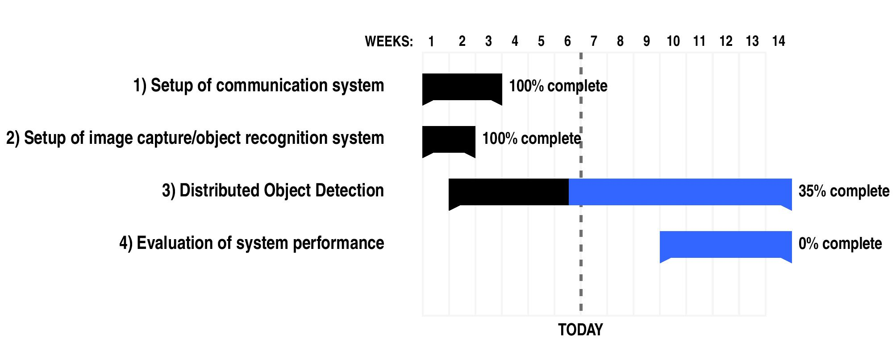
Progress
What? – Related Work – How? – Progress
École polytechnique fédérale de Lausanne – A.Y. 2018/2019 – Marco Zoveralli – Sciper N. 267476
1/11
7/7
Notes:
Infer about BIP, say that we discuss later about the tools

Slide 15
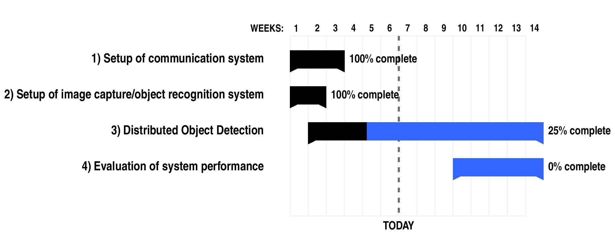
Progress
What? – Related Work – How? – Progress
École polytechnique fédérale de Lausanne – A.Y. 2018/2019 – Marco Zoveralli – Sciper N. 267476
1/11
7/7
Notes:
Infer about BIP, say that we discuss later about the tools

Slide 16
Protocol Design
Intra-host
Inter-host
Aggregate local predictions with received ones
Weighted average over the set of predictions
Emission of final result
Challenges
Give the proper weight to each device’s prediction
Reach a consensus
Handle packet losses
What? – Related Work – How? – Progress
École polytechnique fédérale de Lausanne – A.Y. 2018/2019 – Marco Zoveralli – Sciper N. 267476
1/11
4/4
Notes:
Infer about BIP, say that we discuss later about the tools

Slide 17


Slide 18
Protocol Design
Intra-host
Local predictions accumulated in an “opinion vector”
Exponential weighted moving average to update the information
Accumulated information: prediction score, bounding-box/image ratio
Results propagated after some predictions
Inter-host
Aggregate local predictions with received ones
Weighted average over the set of predictions
Emission of final result
Challenges
Give the proper weight to each device’s prediction
Reach a consensus
Handle packet losses
What? – Related Work – How? – Progress
École polytechnique fédérale de Lausanne – A.Y. 2018/2019 – Marco Zoveralli – Sciper N. 267476
1/11
4/4
Notes:
Infer about BIP, say that we discuss later about the tools

Slide 19
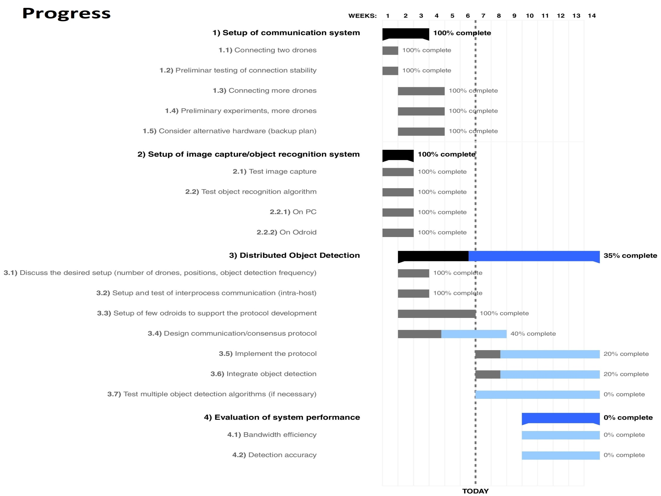
Simple Network Management Protocol
Model Checking: Abstraction VS Refinement
Why? – What? – How? – Progress – Conclusion
École polytechnique fédérale de Lausanne – A.Y. 2016/2017 – Marco Zoveralli – Sciper N. 267476
7/26
Notes:
What does model checking do? A little background.

Slide 20
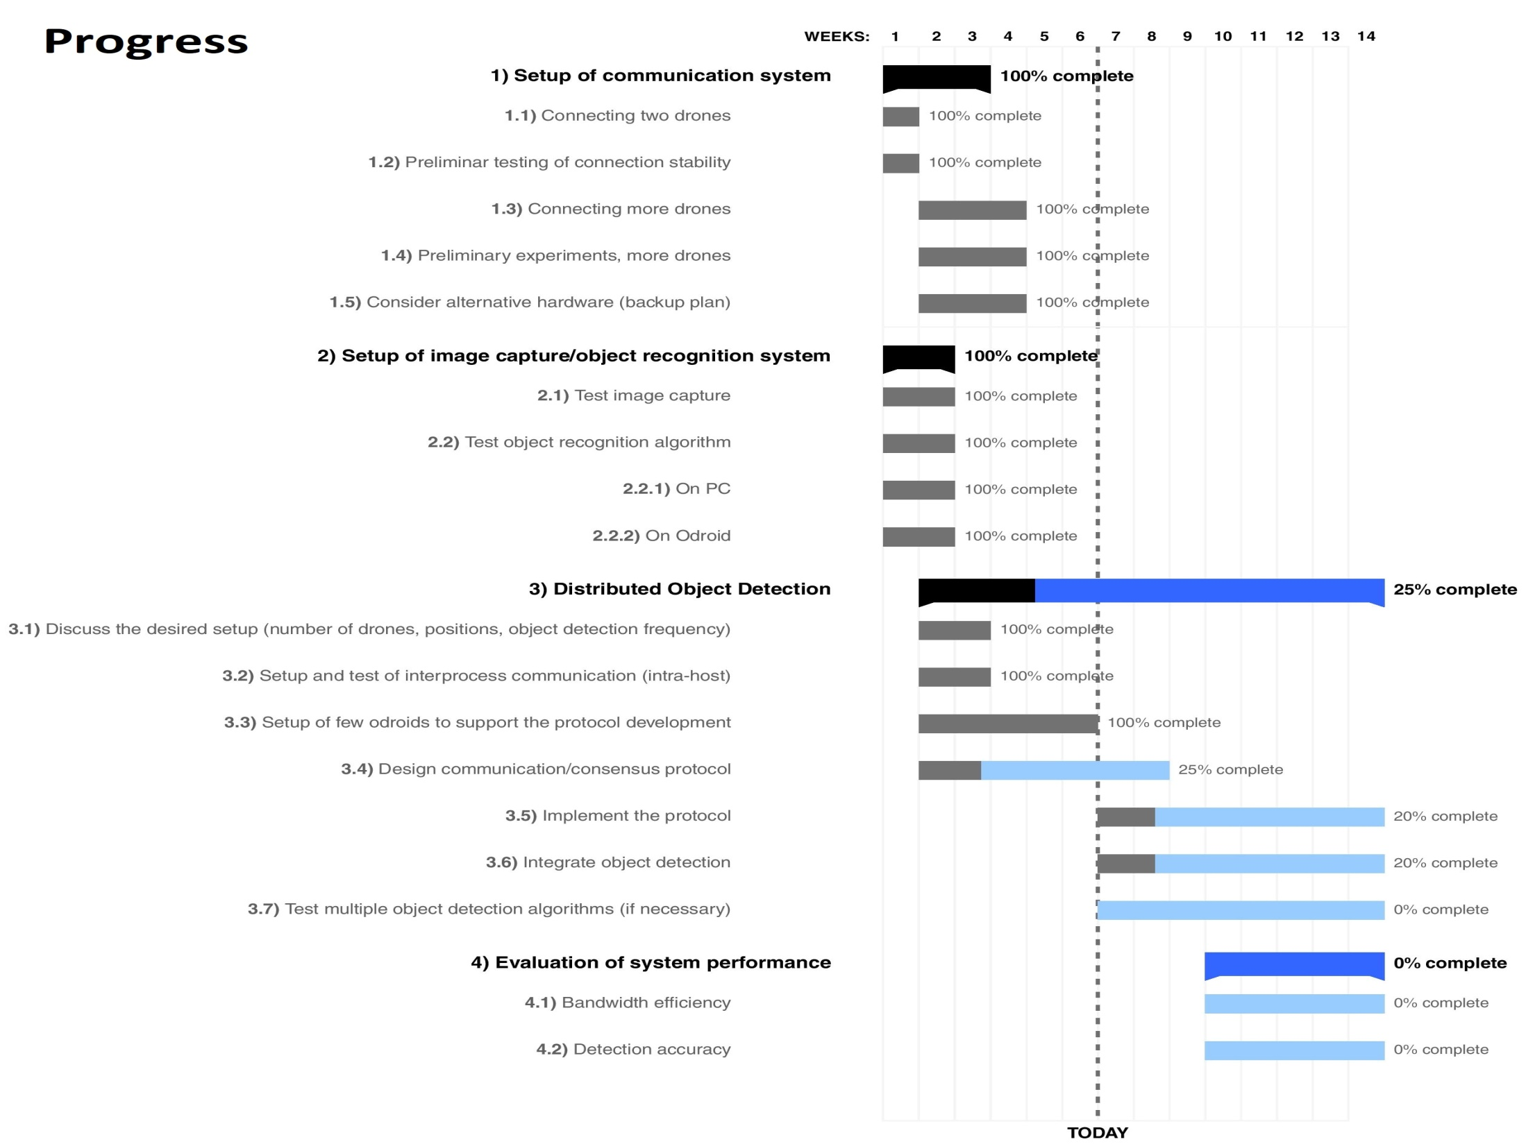
Simple Network Management Protocol
Model Checking: Abstraction VS Refinement
Why? – What? – How? – Progress – Conclusion
École polytechnique fédérale de Lausanne – A.Y. 2016/2017 – Marco Zoveralli – Sciper N. 267476
7/26
Notes:
What does model checking do? A little background.

